Slide 1
FPT DORMITORY MANAGEMENT
TRỊNH BÁ MINH NINH
VŨ TIẾN KHÔI
PHẠM TIẾN ĐẠT
NGUYỄN KHƯƠNG QUÂN

Slide 2
I. INTRODUCTION
- The FPT Dormitory Management Website is the new dormitory management website for FPT students.
- The main object of the project is to replace the old dormitory management website with the new one which is more effective and easier to use for FPT Student.

Slide 3
II. Tools and technique
TOOLS:
Visual Studio Code
Microsoft Visual Studio
SQL Server Management Studio
Frontend:
Bootstrap 4.6
jQuery
Backend:
.Net Framework 4.7.2
ASP .Net MVC5
Entity Framework
SQL Server

Slide 4
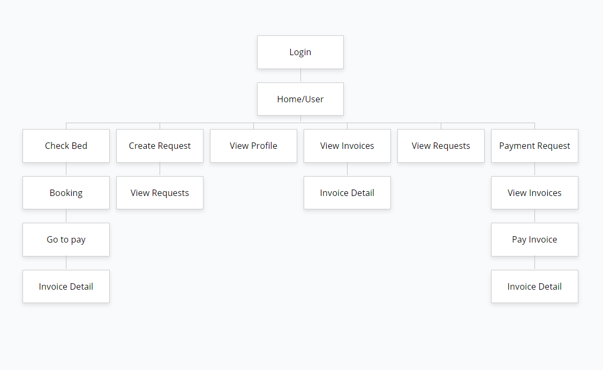
III.1 User sitemap

Slide 5
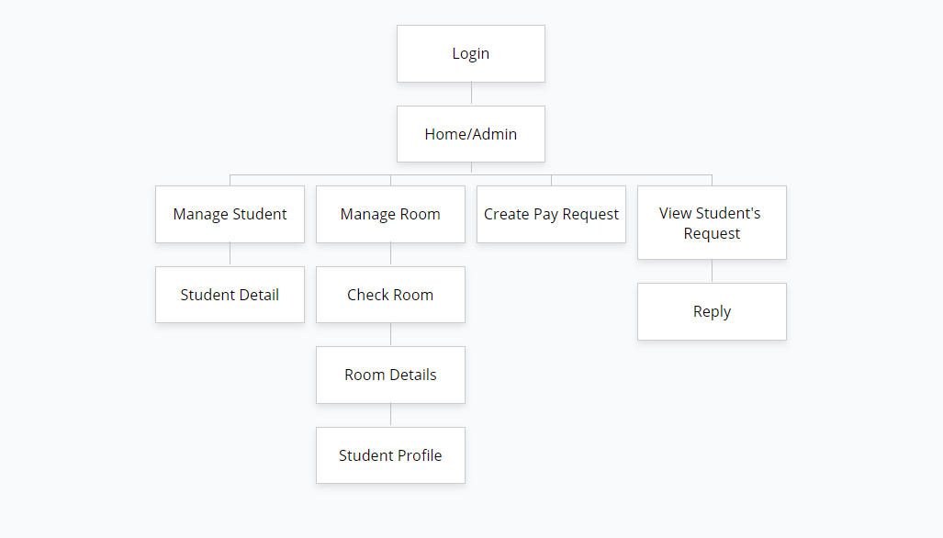
III.2 ADMIN SITEmap

Slide 6
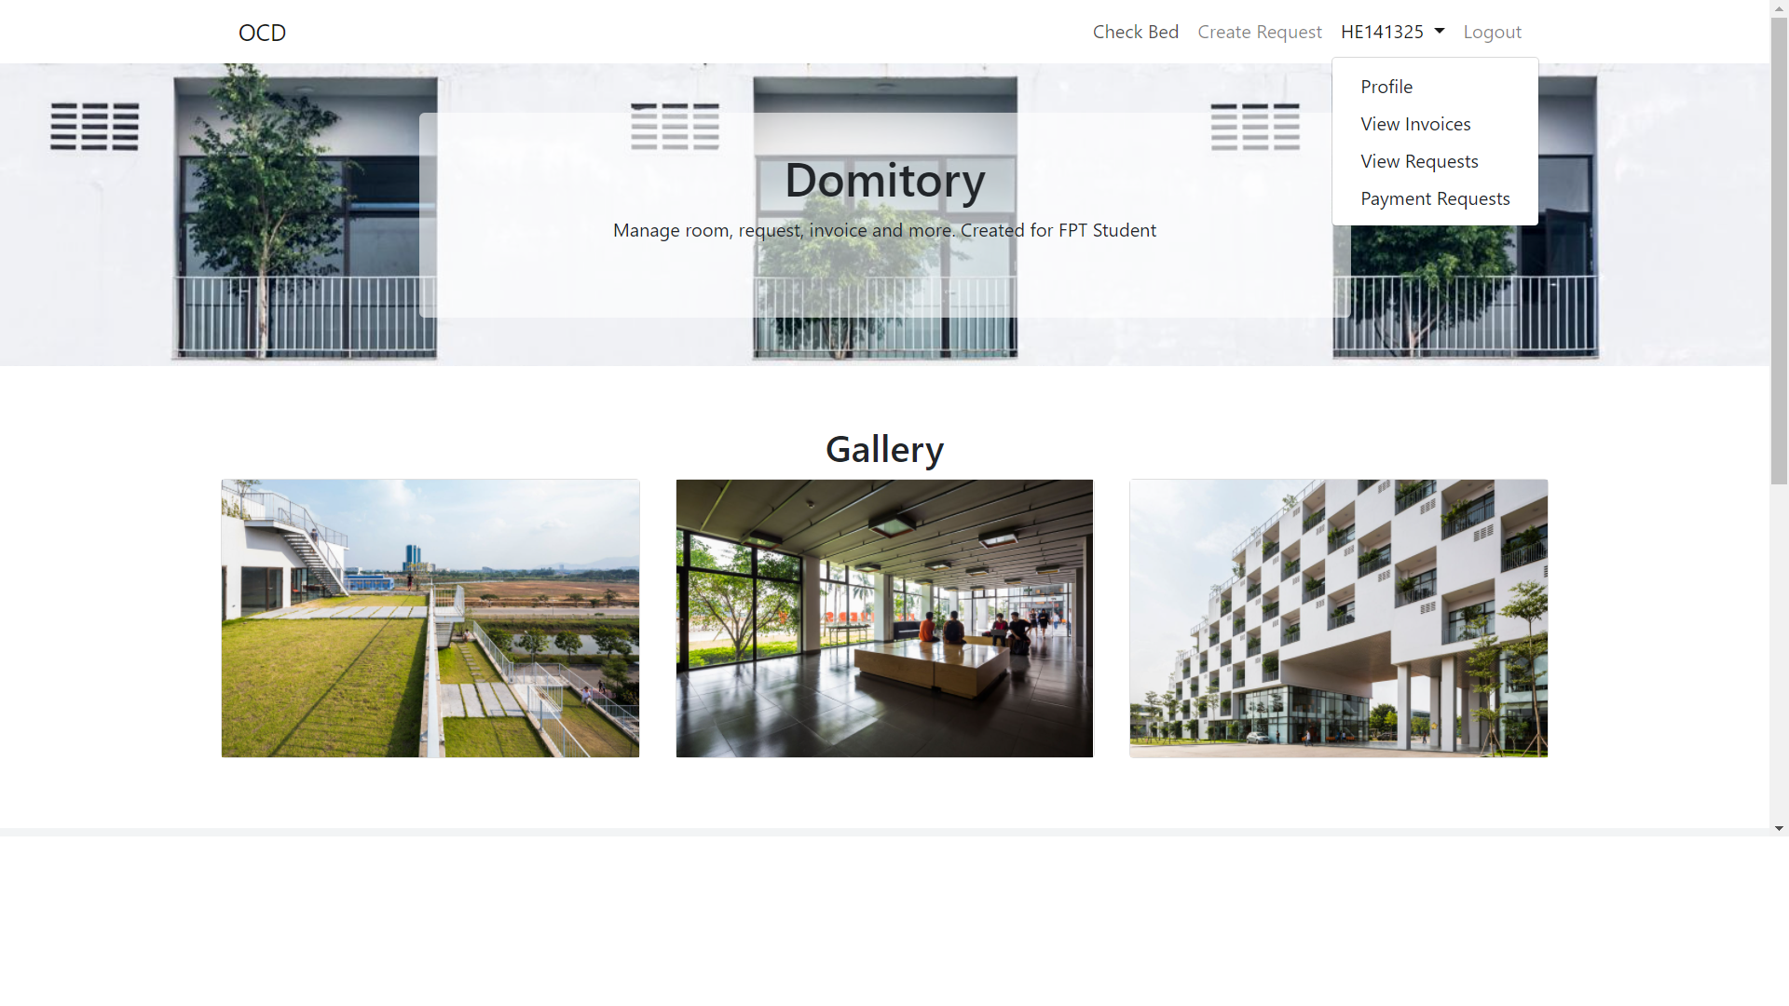
1. User Homepage
IV.1 User Function

Slide 7
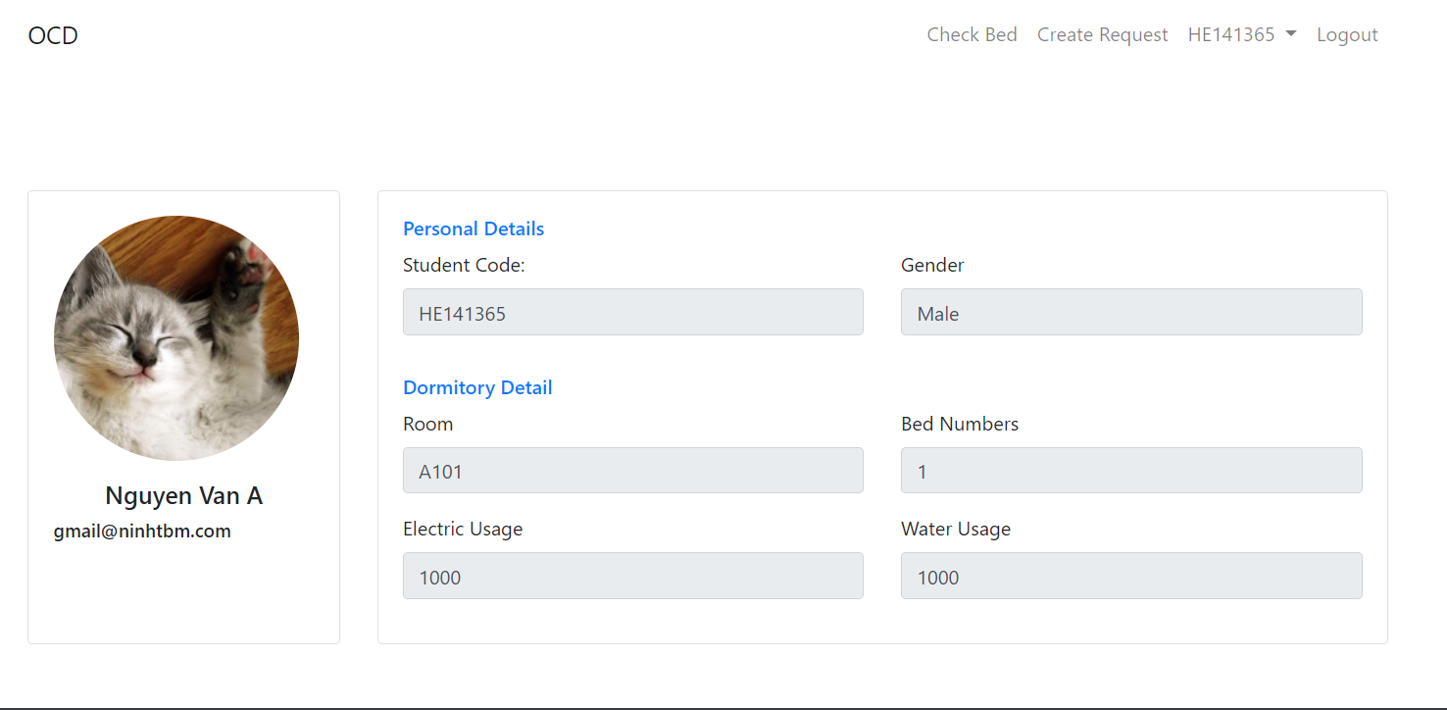
2. Profile

Slide 8
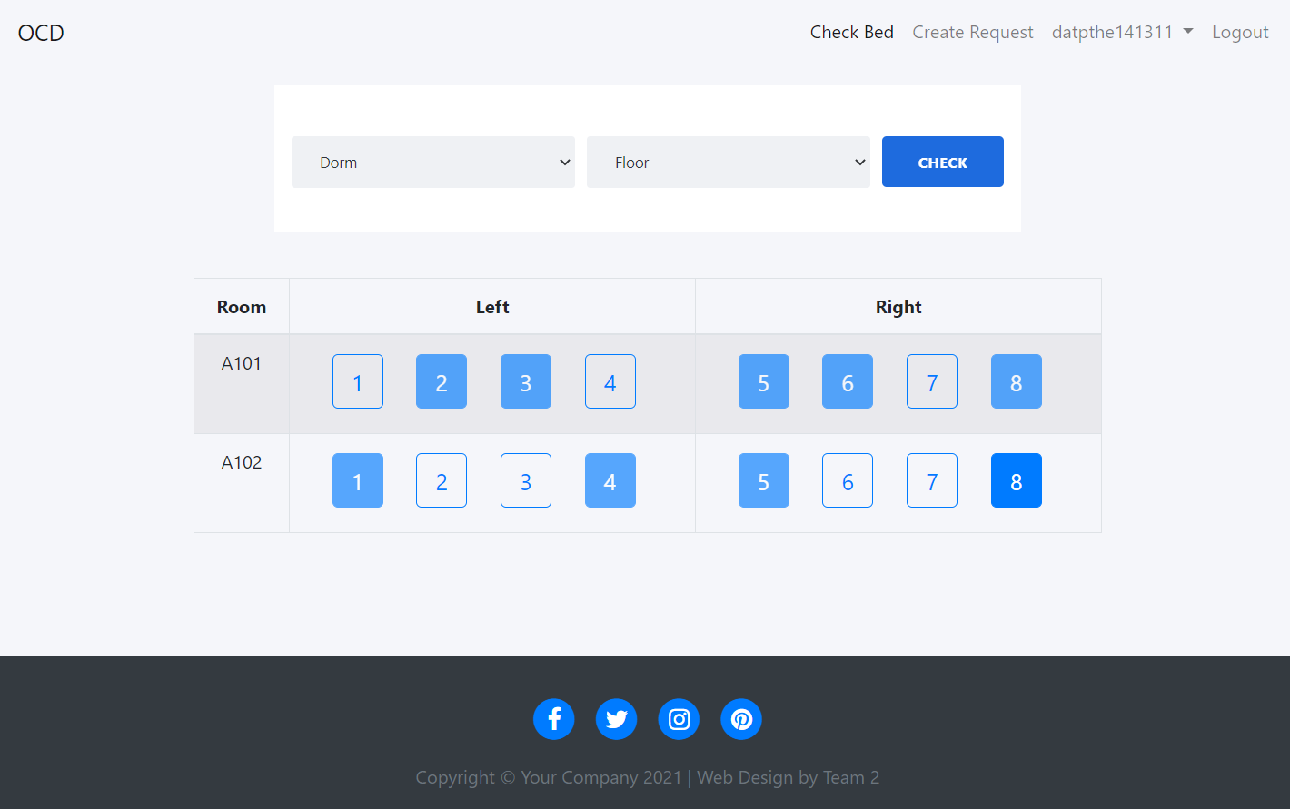
3. Check bed

Slide 9
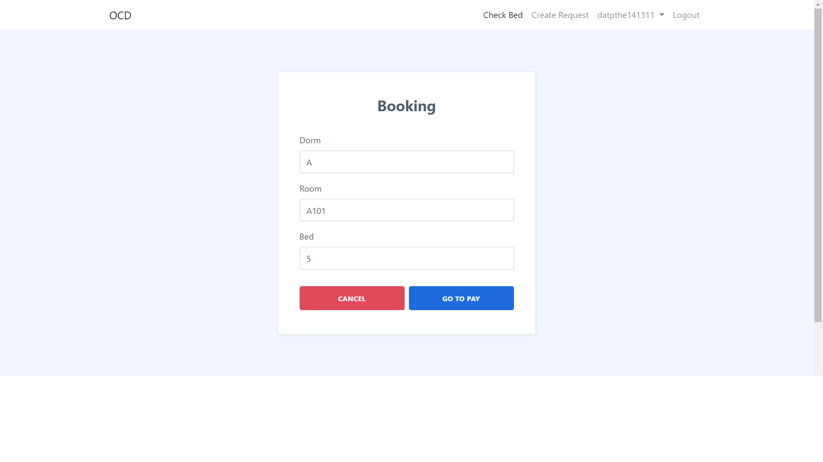
4. Booking

Slide 10
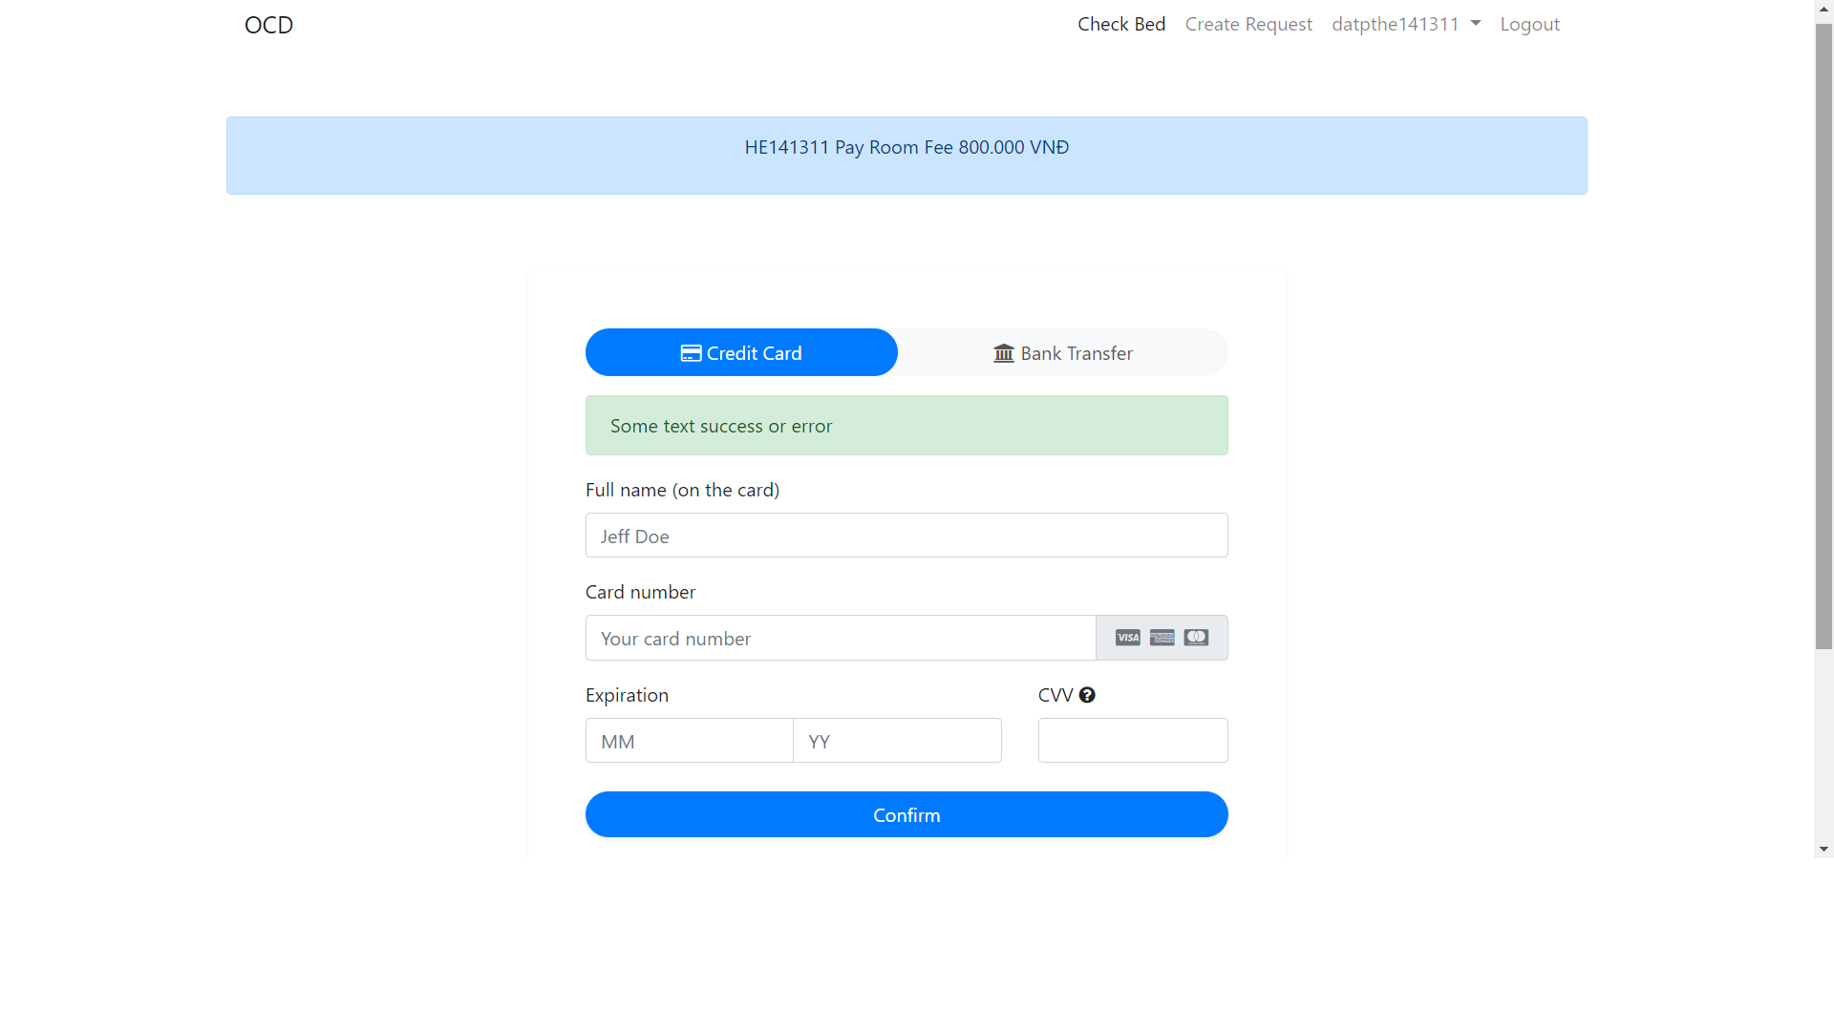
5. payment

Slide 11
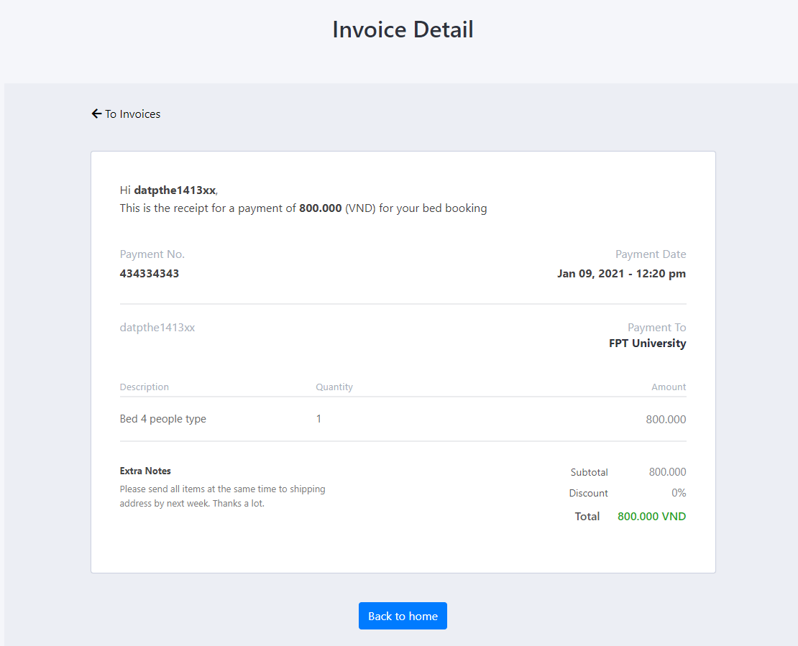
6.Invoice Detail

Slide 12
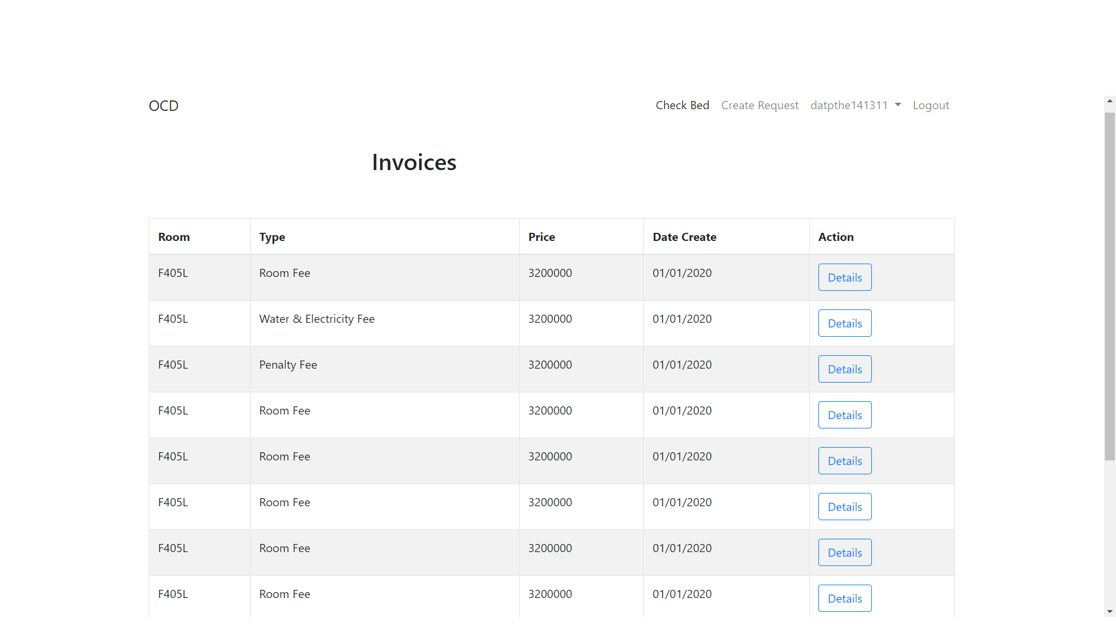
7. Invoice

Slide 13
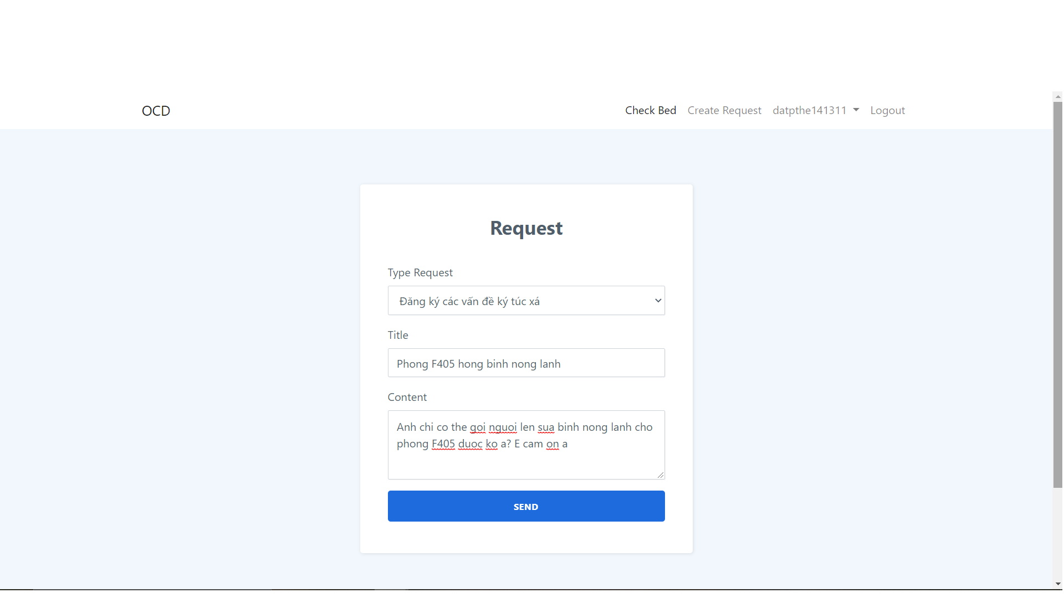
8. Create request

Slide 14
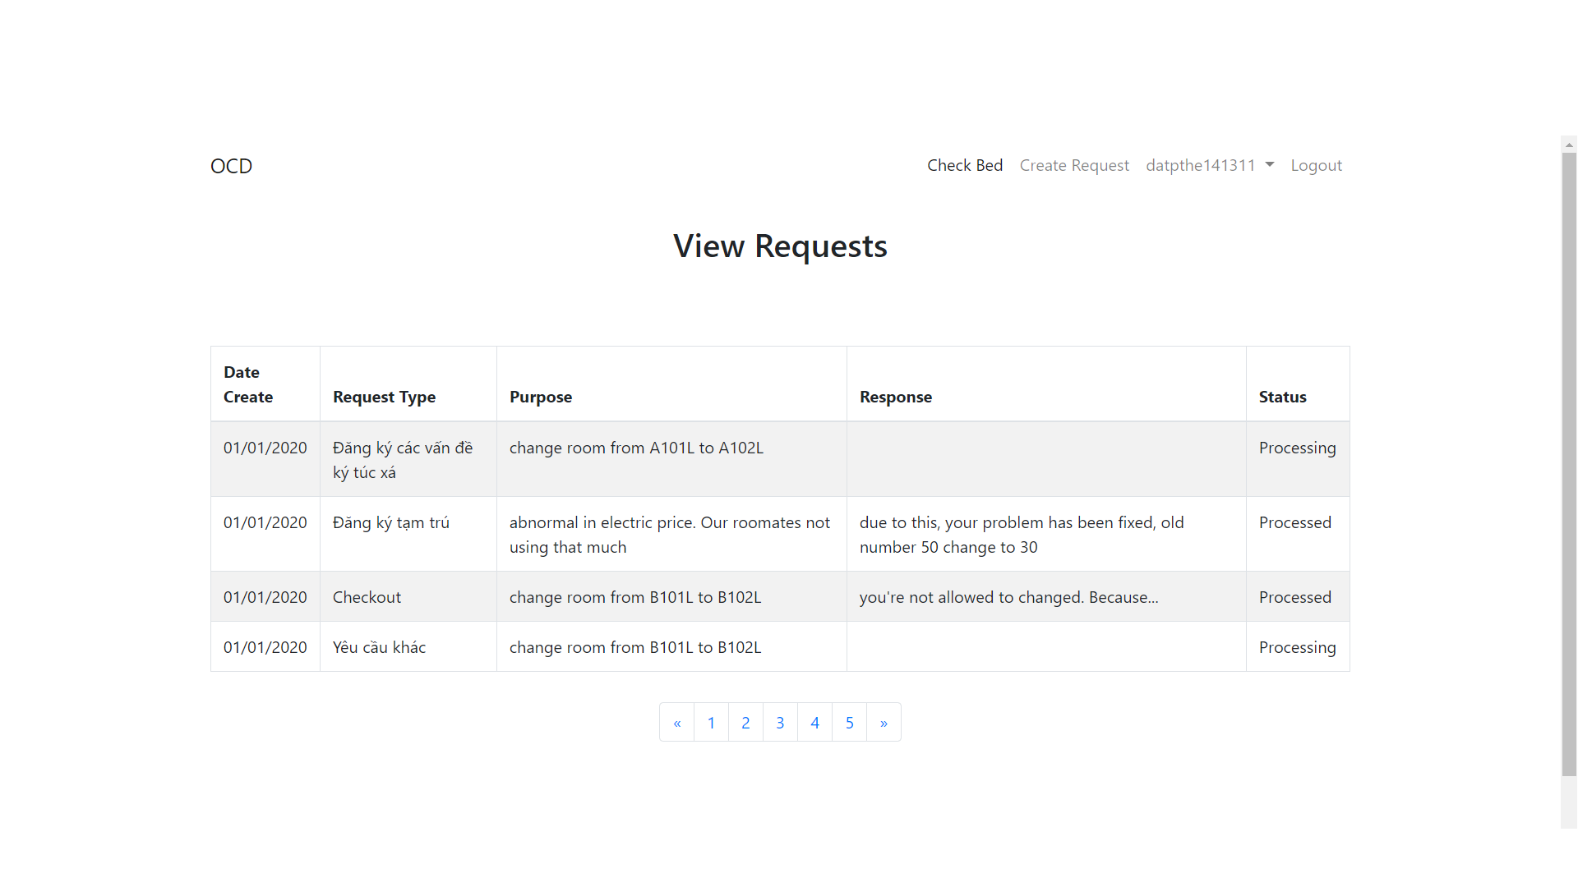
9. View request

Slide 15
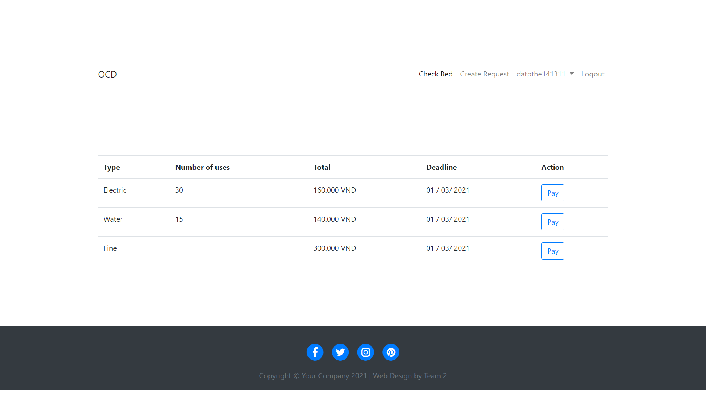
10.Payment request

Slide 16
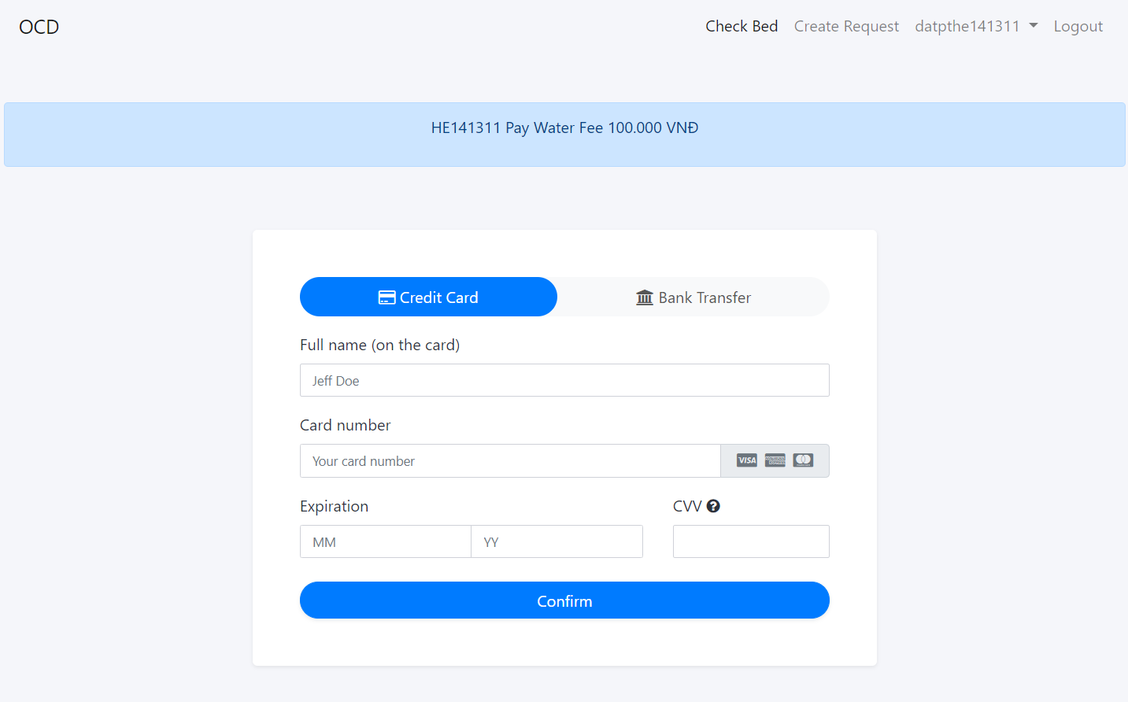
11. Water Payment

Slide 17
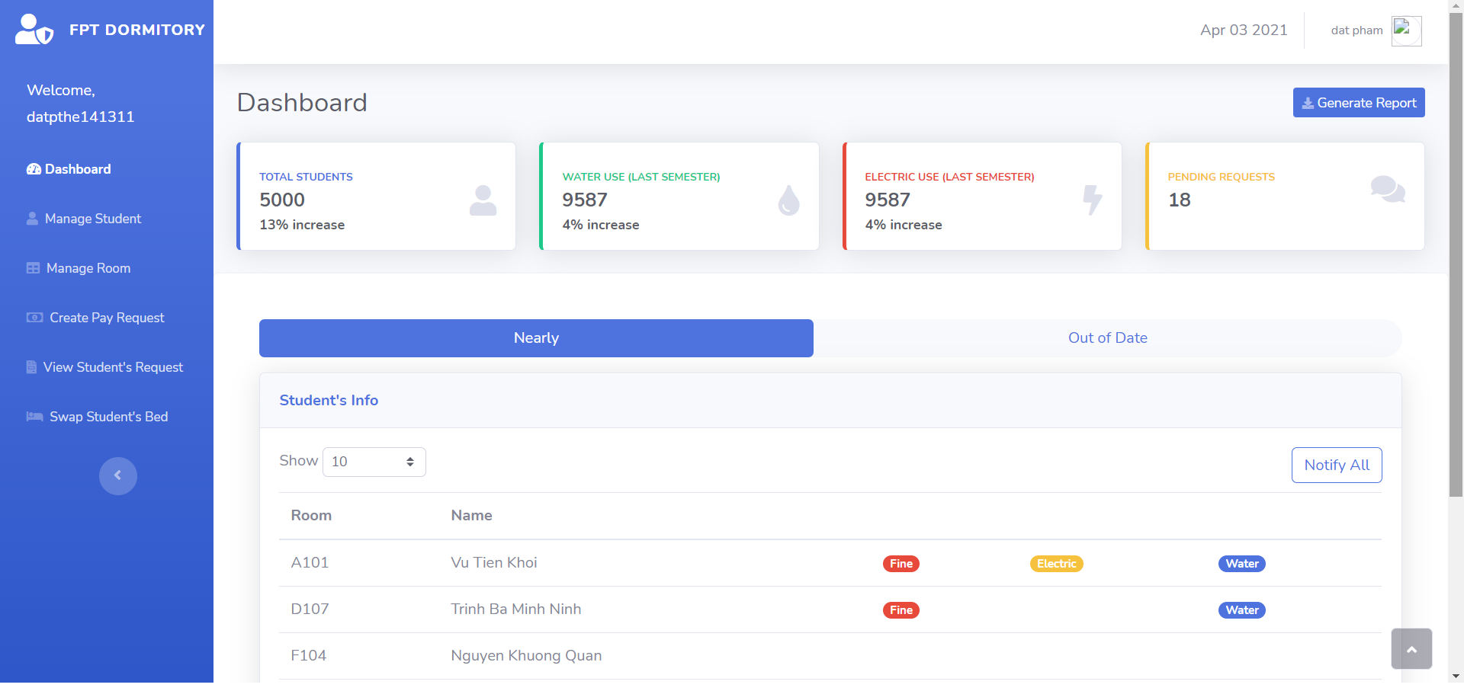
IV.2 admin function
1. dashboard

Slide 18
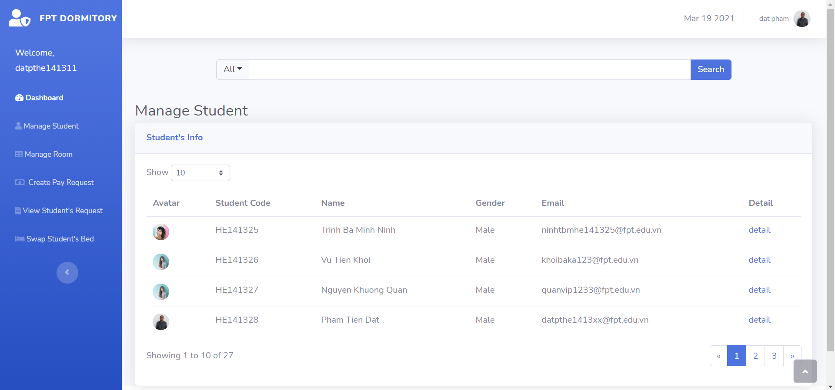
2. Manage student

Slide 19
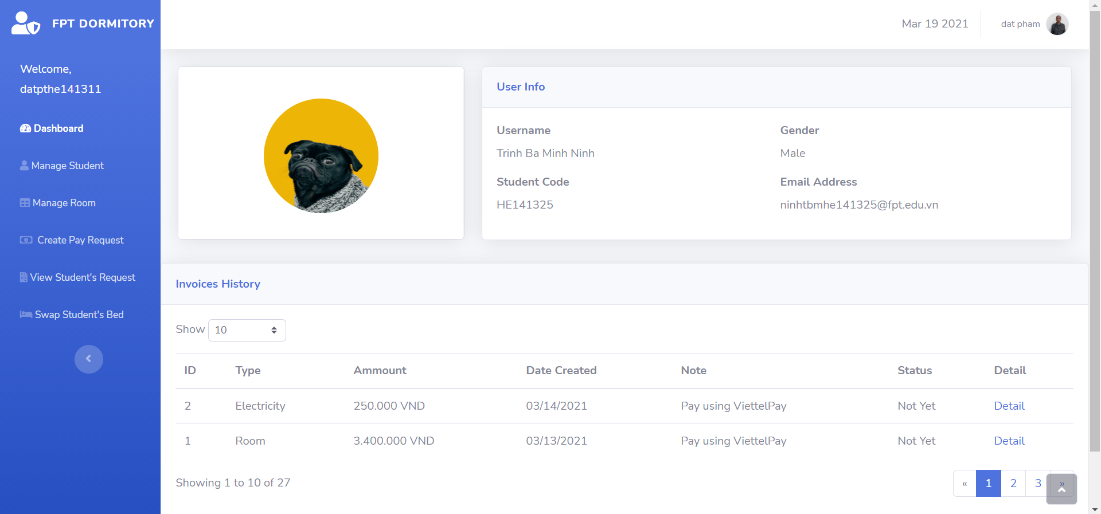
3.Student profile

Slide 20
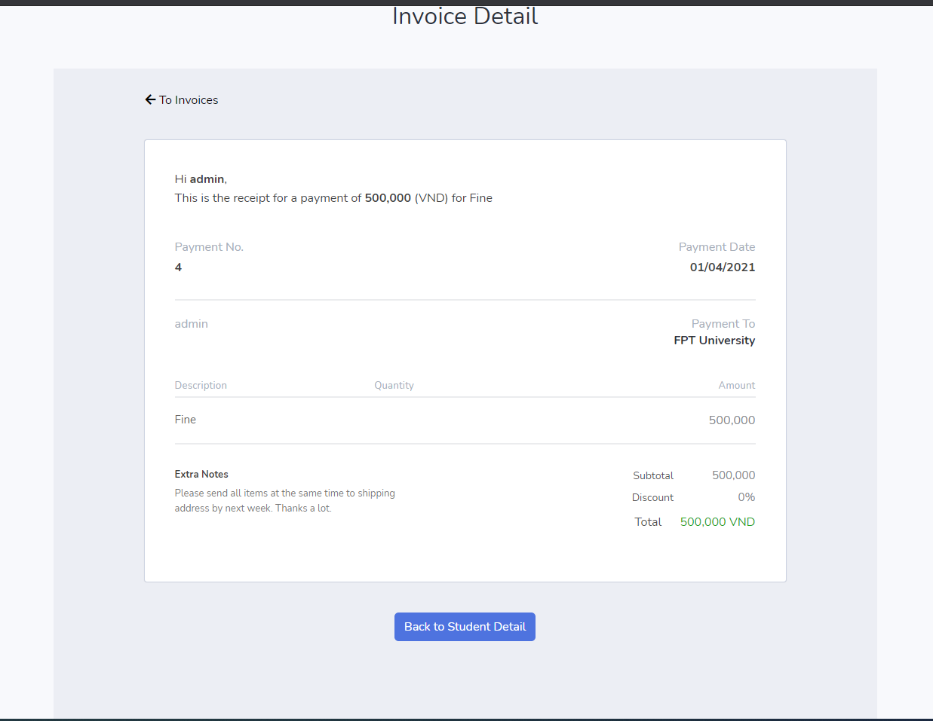
4. Invoice Detail

Slide 21
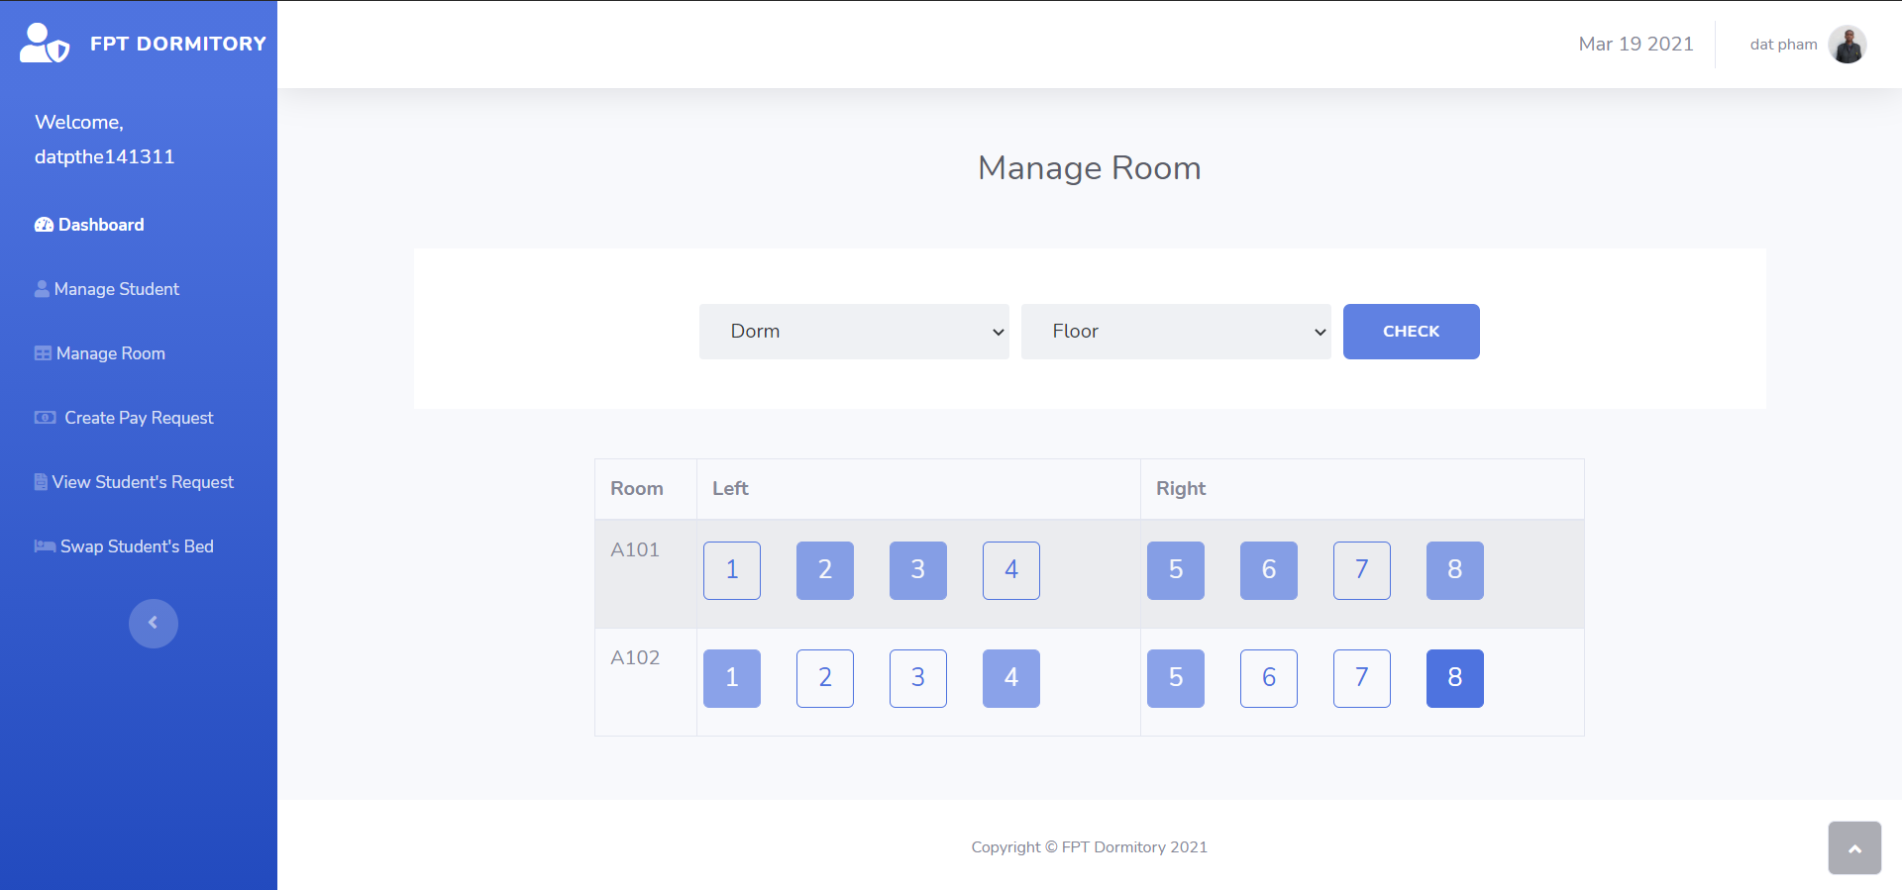
5. Manage room

Slide 22
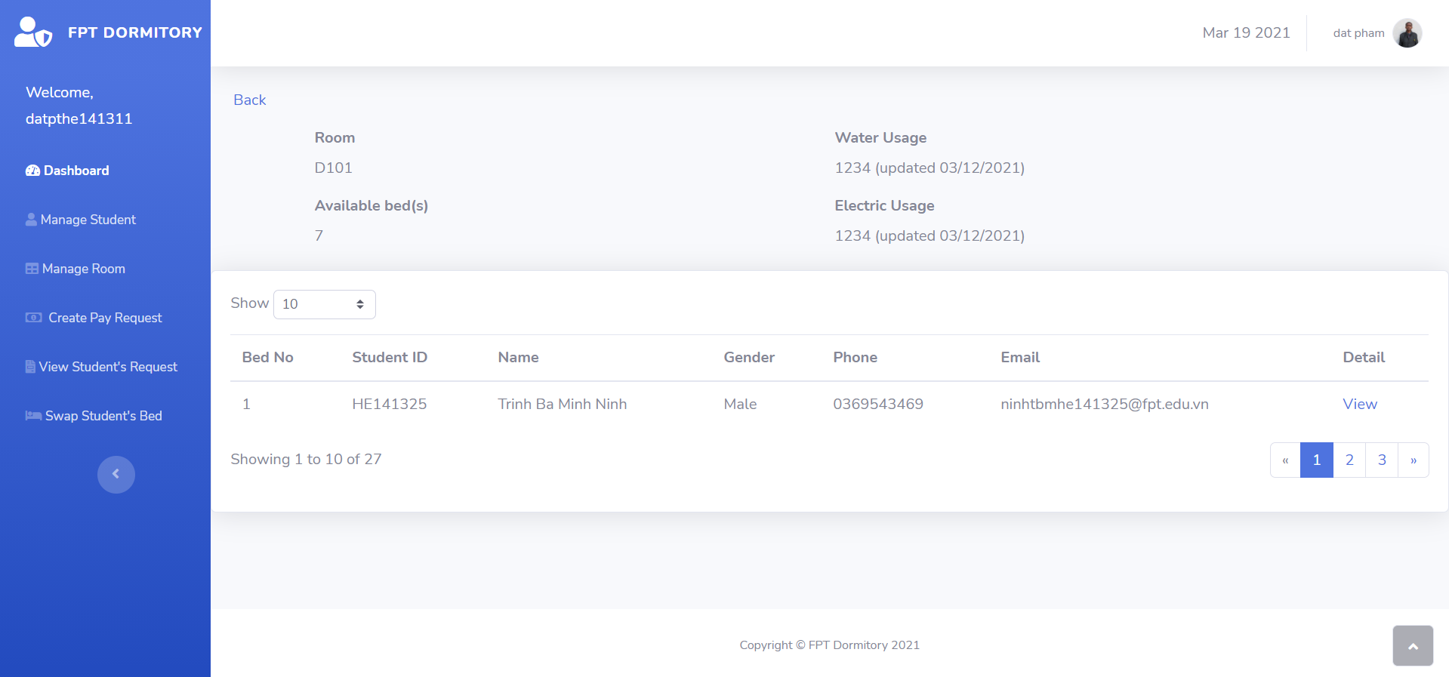
6. Room detail

Slide 23
7.Student profile

Slide 24
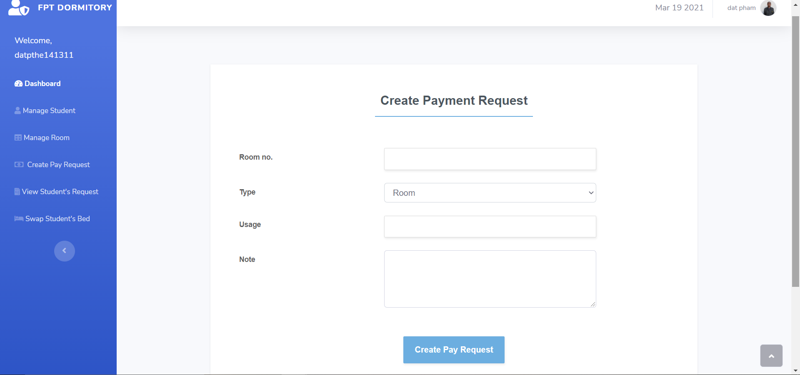
8. Create payment request

Slide 25
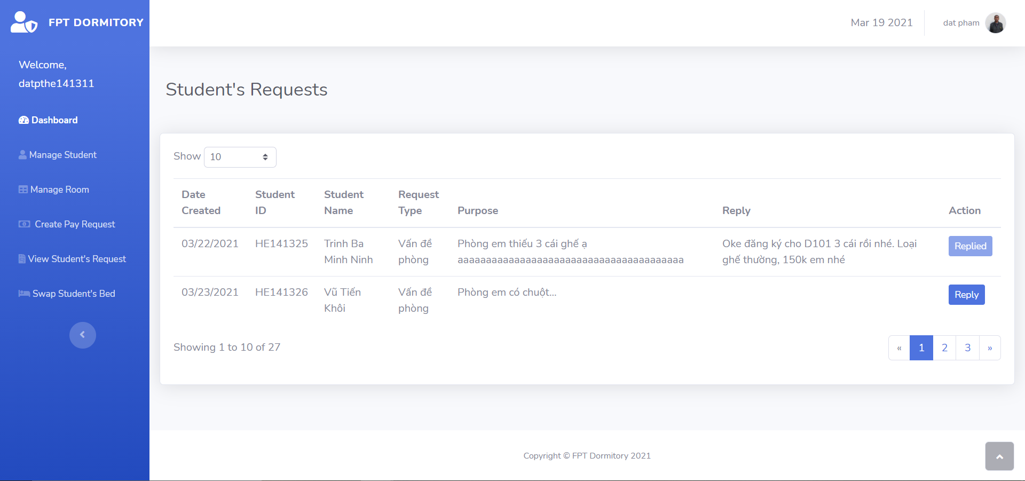
9. View Request

Slide 26
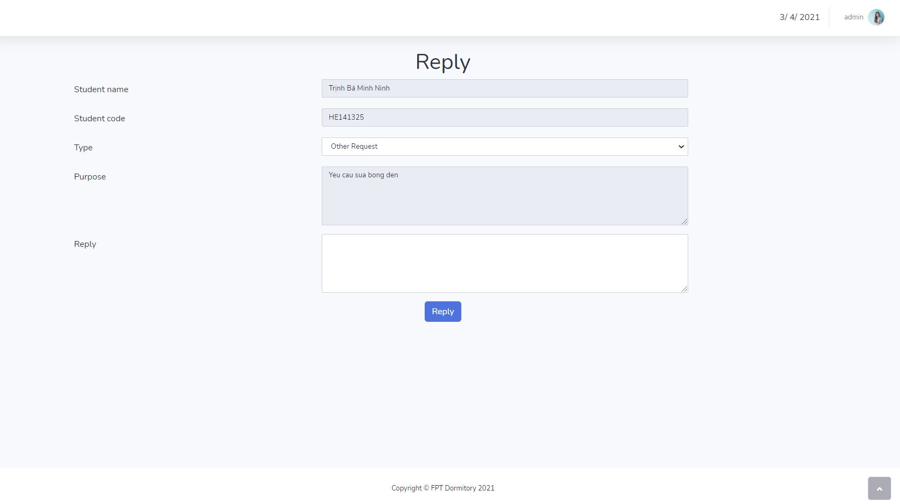
10. Reply Request

Slide 27
V. Works
Khôi | Ninh | Đạt | Quân
User Sent Request, View Request | User Book Room | Front End | Mockup
View Invoice History | Use View Payment Request | Database | Slide
User View Invoice detail | User Pay Invoice | Login | Admin - View Profile Student
Admin Manage Student | Admin Create Pay Request | Logout
Reply Student Request | Admin Manage Room | View Profile User
Admin Dashboard | User Homepage | Clone Data
 | Business Analyst | Business Analyst

